Slide 1
International Trade and Economic Development
Chapter 11

Slide 2
LEARNING GOALS:
Understand the relationship between international trade and economic development
Understand the relationship between the terms of trade and export instability and economic development
Compare imports substitution with export orientation as a development strategy
Describe the current problems facing developing countries

Slide 3
Introduction
With the exception of a handful of nations in North America, Western Europe, Japan, Australia, and New Zealand, most nations of the world are classified as less developed or, to put it more positively, as developing countries.
In relation to developed (or more developed) countries, developing nations are characterized in general by low (and sometimes extremely low) average real per capita income, a high proportion of the labor force in agriculture and other primary activities such as mineral extraction, low life expectancies, high rates of illiteracy, high rates of population growth, and low rates of growth in average real per capita income.

Slide 4
Introduction
In the past, the economic relationship between the developed and developing nations was characterized by developing nations exporting primarily food and raw materials in exchange for manufactured goods from developed nations.
This is still the case for the poorest developing nations, but not for the more advanced ones.
In 1980, manufactured products were only 25 percent of developing country exports; by 2010, that figure exceeded 80 percent (UNCTAD, 2011).

Slide 5
Introduction
Until the 1980s, international trade and the functioning of the present international economic system hindered rather than facilitated development through secularly declining terms of trade and widely fluctuating export earnings for developing nations.
Comparative advantage was completely irrelevant for developing nations and the development process.
Therefore, they advocated industrialization through import substitution (i.e., the domestic production of manufactured goods previously imported) and generally placing less reliance on international trade by developing nations.

Slide 6
The Importance of Trade to Development
We analyze the claim that international trade theory is irrelevant for developing nations and to the development process.
Then we examine the ways in which international trade operated as an “engine of growth” for the so-called regions of recent settlement in the nineteenth century and the reasons it can no longer be relied on to the same extent by today’s developing nations.
International trade can still contribute to the process of economic development today.

Slide 7
Trade Theory and Economic Development
According to traditional trade theory, if each nation specializes in the production of the commodity of its comparative advantage, world output will be greater and, through trade, each nation will share in the gain.
With the present distribution of factor endowments and technology between developed and developing nations, the theory of comparative advantage thus prescribes that developing nations should continue to specialize primarily in the production of and export of raw materials, fuels, minerals, and food to developed nations in exchange for manufactured products.

Slide 8
Trade Theory and Economic Development
While this may maximize welfare in the short run, developing nations believe that this pattern of specialization keeps them from reaping the benefits of industry and maximizing their welfare in the long run.
The benefits resulting from industrial production are a more trained labor force, more innovations, higher and more stable prices for the nation’s exports, and higher income for its people.
With developing nations specializing in primary commodities and developed nations specializing in manufactured products, leave developing nations poor, undeveloped, and dependent.
This belief is reinforced by the observation that all developed nations are primarily industrial, whereas most developing nations are, for the most part, primarily agricultural or engaged in mineral extraction or the production of simple manufactured goods.

Slide 9
Trade as an Engine of Growth
During the nineteenth century, most of the world’s modern industrial production was concentrated in Great Britain.
Large increases in industrial production and population in resource-poor Britain led to a rapidly rising demand for the food and raw material exports of the regions of recent settlement (the United States, Canada, Australia, New Zealand …).
For example, during the century from 1815 to 1913, Britain’s population tripled, its real GNP increased 10 times, and the volume of its imports increased 20 times.

Slide 10
Trade as an Engine of Growth
The stimulus provided by their rapidly expanding exports then spread to the rest of the economy of these newly settled lands through the familiar accelerator-multiplier process.
Thus, according to Nurkse (1970), the export sector was the leading sector that propelled these economies into rapid growth and development.
That is, international trade functioned as an engine of growth for these nations during the nineteenth century.

Slide 11
Trade as an Engine of Growth
It is generally agreed that today’s developing nations can rely much less on trade for their growth and development.
This is due to less favorable demand and supply conditions.

Slide 12
Trade as an Engine of Growth
On the demand side, it is pointed out that the demand for food and raw materials is growing much less rapidly today than was the case for the regions of recent settlement during the nineteenth century.
There are several reasons for this:
(1) The income elasticity of demand in developed nations for many of the food and agricultural raw material exports of developing nations is less (and sometimes much less) than 1, so that as income rises in developed nations, their demand for the agricultural exports of developing nations increases proportionately less than the increase in income.
For example, the income elasticity of demand for coffee is about 0.8, for cocoa 0.5, for sugar 0.4, and for tea 0.1.

Slide 13
Trade as an Engine of Growth
(2) The development of synthetic substitutes has reduced the demand for natural raw materials; for example, synthetic rubber has reduced the demand for natural rubber, nylon the demand for cotton, and plastics the demand for hides and skins.
(3) Technological advances have reduced the raw material content of many products.
(4) The output of services (with lower raw material requirements than commodities) has grown faster than the output of commodities in developed nations.
(5) Developed nations have imposed trade restrictions on many temperate exports (such as wheat, vegetables, sugar, oils, and other products) of developing nations.

Slide 14
Trade as an Engine of Growth
On the supply side, most of today’s developing nations are much less well endowed with natural resources (except for petroleum-exporting nations) than were the regions of recent settlement during the nineteenth century.
In addition, most of today’s developing nations are over-populated, so that most of any increase in their output of food and raw materials is absorbed domestically rather than exported.

Slide 15
Trade as an Engine of Growth
Furthermore, the international flow of capital to most developing nations today is relatively much less than it was for the regions of recent settlement in the nineteenth century, and today’s developing nations seem also to face an outflow of skilled labor rather than an inflow.
Finally, it is also true that until the 1990s, developing nations have somewhat neglected their agriculture in favor of more rapid industrialization, thereby hampering their export (and development) prospects.

Slide 16
The Contributions of Trade to Development
Even though international trade cannot in general be expected to be an “engine of growth” today, there are still many ways (besides the static gains from comparative advantage) in which it can contribute to the economic growth of today’s developing nations.

Slide 17
The Contributions of Trade to Development
Important beneficial effects that international trade can have on economic development:
(1) Trade can lead to the full utilization of otherwise underemployed domestic resources.
That is, through trade, a developing nation can move from an inefficient production point inside its production frontier, with unutilized resources because of insufficient internal demand, to a point on its production frontier with trade.
For such a nation, trade would represent a vent for surplus, or an outlet for its potential surplus of agricultural commodities and raw materials.
This has indeed occurred in many developing nations, particularly those in Southeast Asia and West Africa.

Slide 18
The Contributions of Trade to Development
(2) by expanding the size of the market, trade makes possible division of labor and economies of scale.
This is especially important in the production of light manufactures in small economies in the early stages of development.
(3) International trade is the vehicle for the transmission of new ideas, new technology, and new managerial and other skills.
(4) Trade also stimulates and facilitates the international flow of capital from developed to developing nations.
In the case of foreign direct investments, where the foreign firm retains managerial control over its investment, the foreign capital is likely to be accompanied by foreign skilled personnel to operate it.

Slide 19
The Contributions of Trade to Development
(5) In several large developing nations, such as Brazil and India, the importation of new manufactured products stimulated domestic demand until efficient domestic production of these goods became feasible.
Finally, (6) international trade is an excellent antimonopoly weapon because it stimulates greater efficiency by domestic producers to meet foreign competition.
This is particularly important to keep low the cost and price of intermediate or semi finished products used as inputs in the domestic production of other commodities.

Slide 20
International Trade and Endogenous Growth Theory
Recent developments in endogenous growth theory starting with Romer (1986) and Lucas (1988) provide a more convincing and rigorous theoretical basis for the positive relationship between international trade and long-run economic growth and development.
Specifically, the new theory of endogenous economic growth postulates that lowering trade barriers will speed up the rate of economic growth and development in the long run .

Slide 21
International Trade and Endogenous Growth Theory
Lowering trade barriers will speed up the rate of economic growth and development in the long run by
(1) allowing developing nations to absorb the technology developed in advanced nations at a faster rate than with a lower degree of openness,
(2) increasing the benefits that flow from research and development
(3) promoting larger economies of scale in production,
(4) reducing price distortions and leading to a more efficient use of domestic resources across sectors,
(5) encouraging greater specialization and more efficiency in the production of intermediate inputs, and
(6) leading to the more rapid introduction of new products and services.

Slide 22
The East Asian Miracle of Growth and Trade
High-Performance Asian Economies (HPAEs)
These include Hong Kong, Korea, Singapore, and Taiwan (the so-called four “tigers,” which started rapid growth in the 1960s), as well as Malaysia, Indonesia, Thailand, and especially China, which followed them in the high-growth path in the 1970s and 1980s.
The table shows that real GDP grew at the average rate of 6.9 percent in the HPAEs during the 1980–1990 decade and 7.7 percent in the1990–1995 period.

Slide 23
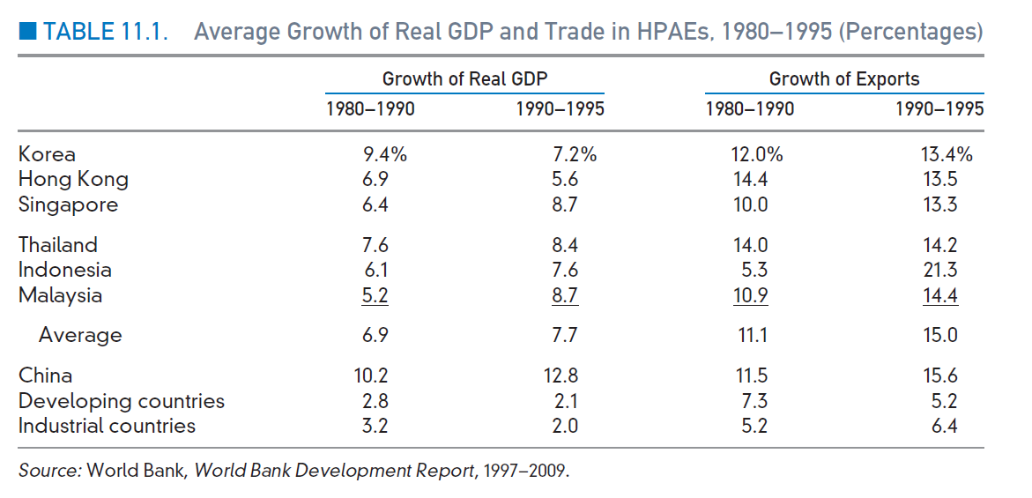
Average Growth of Real GDP and Trade in HPAEs, 1980–1995 (Percentages)

Slide 24
Export-Oriented Industrialization: the East Asian Miracle
From the mid-1960s onward, exports of manufactured goods, primarily to advanced nations, was another possible path to industrialization for the developing countries.
High performance Asian economies (HPAEs)
A group of countries that achieved spectacular economic growth.
In some cases, they achieved economic growth of more than 10% per year.

Slide 25
Export-Oriented Industrialization: the East Asian Miracle
The Facts of Asian Growth
The World Bank’s definition of HPAEs contains three groups of countries, whose “miracle” began at different times :
Japan (after World War II)
The four “tigers”: Hong Kong, Taiwan, South Korea, and Singapore (in the 1960s)
Malaysia, Thailand, Indonesia, and China (in the late 1970s and the 1980s)
The HPAEs are very open to international trade
Example: In 1999, exports as a share of gross domestic product in the case of both Hong Kong and Singapore exceeded 100% of GDP (132 and 202 respectively).

Slide 26
East Asian Miracle

Slide 27
East Asian Miracle

Slide 28
Export-Oriented Industrialization: the East Asian Miracle
Trade Policy in the HPAEs
Some economists argue that the “East Asian miracle” is the payoff to the relatively open trade regime.

Slide 29
The Terms of Trade and Economic Development
We then analyze the alleged reasons for expecting the commodity terms of trade of developing nations to deteriorate.
Terms of trade (N) as the ratio of the price index of the nation’s exports (PX ) to the price index of its imports (PM ) multiplied by 100 (to express the terms of trade in percentages).
That is:
N = (PX /PM ) *100

Slide 30
Reasons for Deterioration in the Commodity Terms of Trade
The reason is that most or all of the productivity increases that take place in developed nations are passed on to their workers in the form of higher wages and income.
While most or all of the productivity increases that take place in developing nations are reflected in lower prices.
Thus, developed nations, retain the benefits of their own productivity increases in the form of higher wages and income for their workers, and at the same time they also reap most of the benefits from the productivity increases taking place in developing nations through the lower prices that they are able to pay for the agricultural exports of developing nations.

Slide 31
Reasons for Deterioration in the Commodity Terms of Trade
Another reason for expecting the terms of trade of developing nations to deteriorate is that their demand for the manufactured exports of developed nations tends to grow much faster than the latter’s demand for the agricultural and raw material exports of developing nations.
This is due to the much higher income elasticity of demand for manufactured goods than for agricultural commodities and raw materials.

Slide 32
Historical Movement in Terms of Trade
Zanias (2004) showed with Figure 11.1 that the price of primary commodities with respect to the price of manufactured goods (measured along the vertical axis in logarithms, so that equal distances refer to equal percentages) dropped to nearly one-third from 1900 to 1998.

Slide 33
Historical Movement in Terms of Trade

Slide 34
Price Instability and the Primary Exports of Developing Nations
Developing nations often experience wild fluctuations in the prices of their primary exports.
This is due to both inelastic and unstable demand and supply.

Slide 35
Cause and Effects of Export Instability
D and S refer, respectively, to the demand and supply curves of the primary exports of developing nations.
With D and S, the equilibrium price is P.
If S to S ‘, the equilibrium price falls sharply to P’’ . If both D and S shift to D’ and S’ , the equilibrium price falls even more, to P’’ .
If, subsequently, D and S shift back, the equilibrium price moves back up to P.
Thus, price inelastic and unstable D and S curves may lead to wild price fluctuations.

Slide 36
Price Instability and the Primary Exports of Developing Nations

